Slide 1


Development of a thermostat through Arduino
Mattia CAZZOLLA Matr. 987083 Mimma CERRETO Matr. 103090 Emma LACAGNINA Matr. 996364 Giorgia MAIMONE Matr. 991946 Ilaria MONACO Matr. 997111

Slide 2

Introduction
Definition:
A thermostat is a regulating device component which senses the temperature of a physical system and performs actions so that the system’s temperature is maintained near a desired set-point
Applications:
Cells culture system
Ambient thermal regulation
- Thermal incubator
Notes:
The aim of this project was to develop a thermostat relying on Arduino hardware.
By definition A thermostat is a regulating device component which senses the temperature of a physical system and performs actions so that the system’s temperature is maintained near a desired set-point.
There are a lot of application about the use of a thermostat but as biomedical students we decided to address the use of a thermostat for a thermal incubator.
(Consequently we decided to implement also a humidity sensor in order to better supervised the state of the newborn, because we need to simulate the ambient inside the uterus where there is 100% of humidity and a temperature of 37°C in maintained constant. )

Slide 3
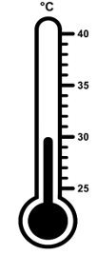
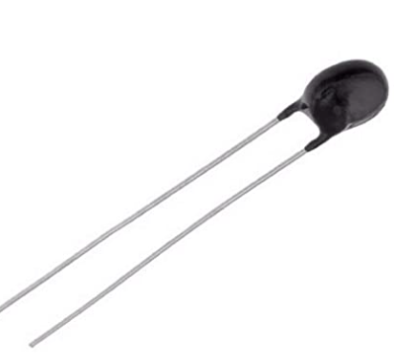
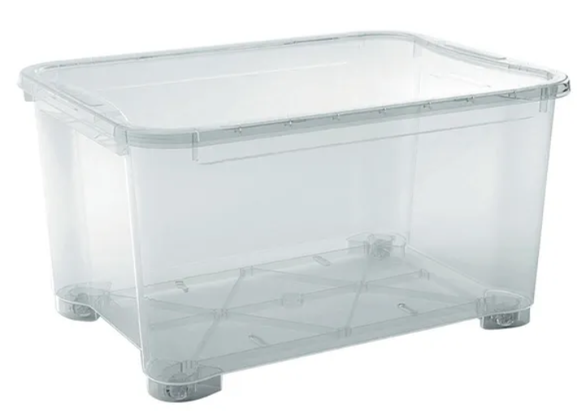
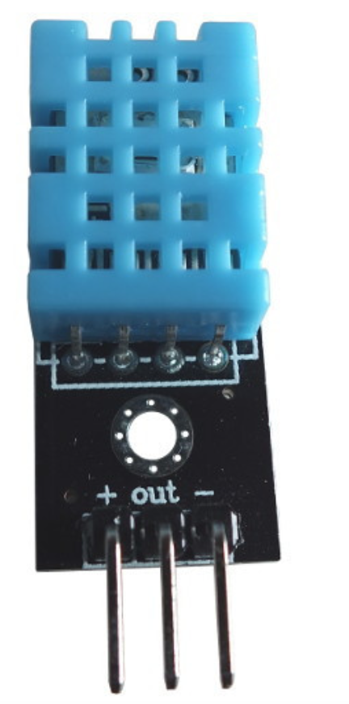

Approach to thermal incubator
Parameters:
Temperature 37°C
Small environment
Humidity 80% - 90%
Notes:
In order to survive and to avoid developing serious health problems, premature newborns are kept at constant body-like temperature (36-37°C) within an adequate range
of humidity (80%-90%) in order to avoid dehydration, consequently we decided to use not only the temperature sensor but also a humidity sensor.
It should be noted that being a protope, dimensions of the device are reduced in order to heat the environment more easily and faster.

Slide 4
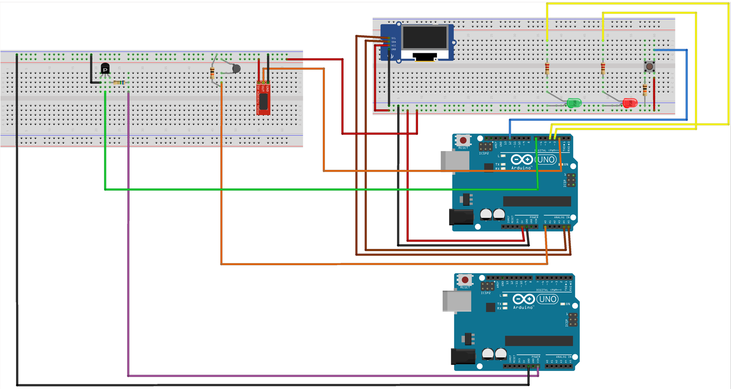

Hardware Schematic of connections
LCD display
Thermistor NTC
ON/OFF
Heating pad
DHT11 Sensor
LED for monitoring
Notes:
For the sake of achieving the desired application described, we decided to use two type of sensors:
- DHT 11: was implemented to detect the current humidity value
- thermistor NTC: was implemented to monitor the current temperature. For this component, as shown in figure, a voltage divider circuit was needed to create a reference voltage to verify the working principle of the sensor, so the resistance of the thermistor decreases with increasing temperatures, thus decreasing also the voltage across the reference voltage divider.
- the element that modifies its behaviour according to the current temperature (to increase it or decrease it) it's the heating pad, which is connected through a mosfet to slightly amplify the flowing current.
Furthermore, moving to the breadboard on the right we have the "monitoring elements": the heating pad is controlled by a monitoring procedure which involves the setted threshold plus/or minus a given range of tollerance but, also by an on/off button (as shown in figure) which can be used by medical operators according to their necessities. Near the button we have two LEDs which activate in two different situations: the green one is ON when the heating pad is working thus warming up the incubator; the red one, on the contrary, it's ON when the temperature lies outside the optimal range for the baby (too hot/too cold).
- The current values of temperature and humidity, together with the setted threshold, can be visualized both through a LCD display or a software application.

Slide 5
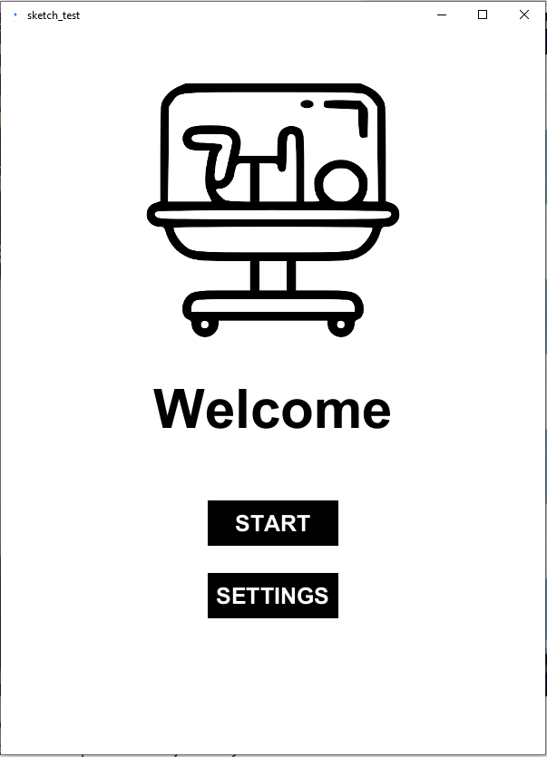
Software Homescreen

Slide 6

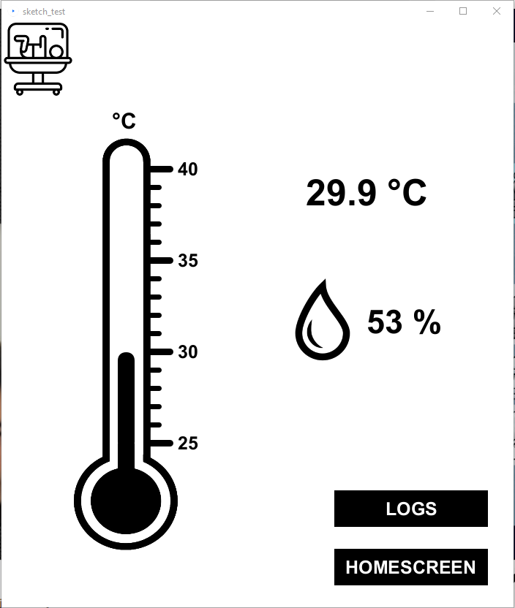
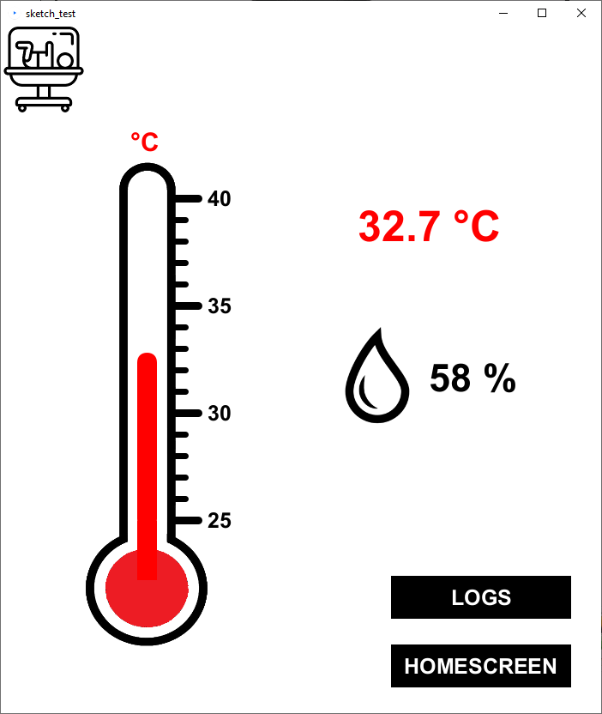
Software Homescreen

Slide 7
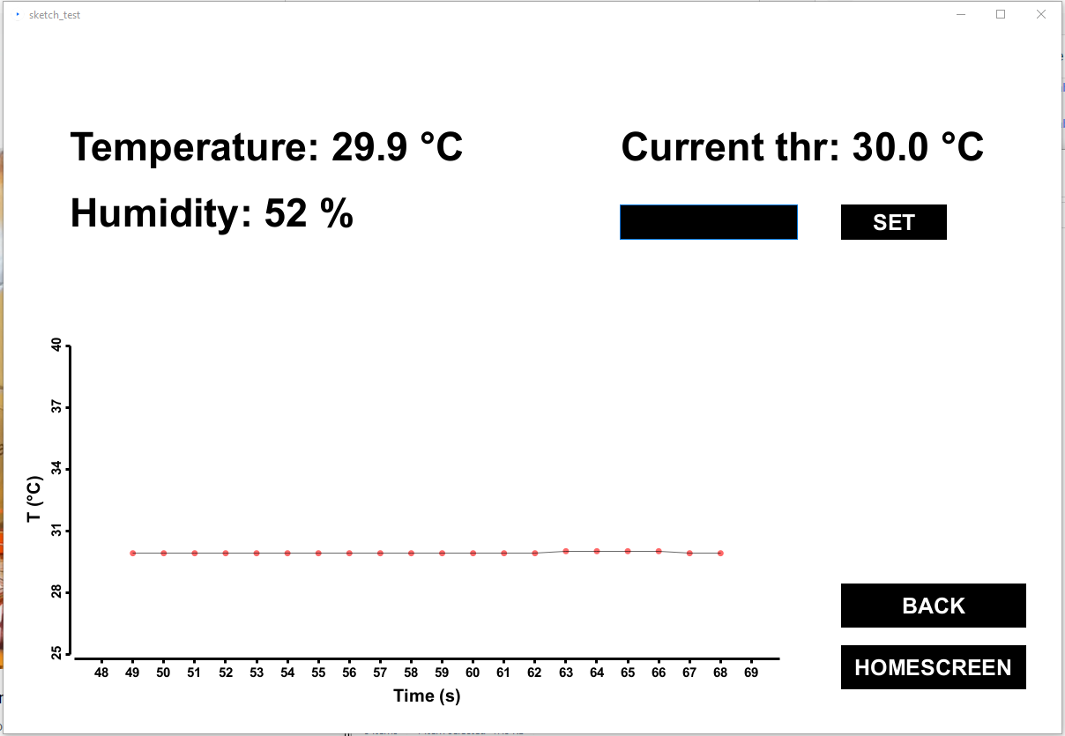
Software Trend

Slide 8
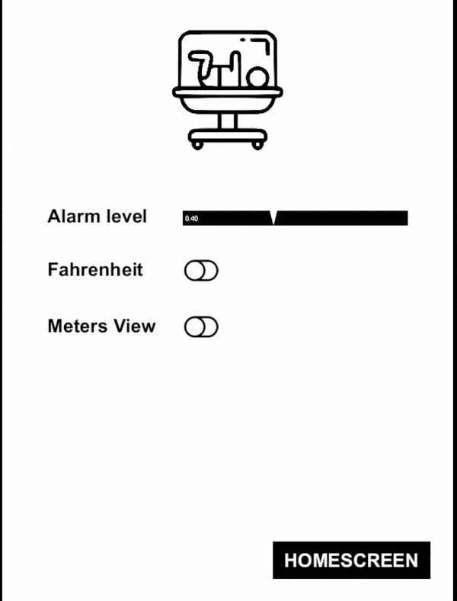
Software Settings
Define the alarm's sound level
Define the temperature scale
Personalize the view in the main page

Slide 9
THE DEMO
Now, let’s go to…

Slide 11
